Slide 1
AIML CAPSTONE PROJECT Pneumonia Detection Challenge
Mentor: Srihari Nalabolu
Team:
Guru Siddarth J
Keyur Singh
Michael Prasan S
M V Pavankumar
Swastika Samanta
Vignesh Jairam

Slide 2
Pneumonia:
Pneumonia is an infection in one or both lungs. Bacteria, viruses, and fungi cause it. The infection causes inflammation in the air sacs in your lungs, which are called alveoli.
Problem Statement ,Objective and Steps:
The aim of the project is to build a model to detect pneumonia by locating the position of inflammation in the given images. The three steps are as follows:
1.Exploratory Data Analysis,Visualization and Pre-processing of data
2.Building the image classification and object detection models
3.Evaluating and fine-tuning the models
Dataset: RSNA Pneumonia Detection Challenge
The dataset we are using is already split into train, test images, train labels and class info.

Slide 3
EDA
EDA observations:
No of Patients with Pneumonia – 6,012 23% of dataset
No of Patients without Pneumonia – 20,672 77% of dataset
Data fields present in stage_2_detailed_class_info:
PatientId - Each patientId corresponds to a unique image
Class – It has three values depending what is the current state of the patient's lung: 'No Lung Opacity / Not Normal', 'Normal' and 'Lung Opacity’.
Normal – 29%
Lung Opacity – 32%
No Lung Opacity / Not Normal – 39%

Slide 4
Image Classification
Dicom images were converted to JPEG format.
Models used and the accuracy:
VGG-16
Resnet50
DenseNet121
Model | Train Accuracy | Test Accuracy
VGG-16 | 0.74725 | 0.782
ResNet50 | 0.6825 | 0.7728
DenseNet121 | 0.7195 | 0.7118

Slide 5
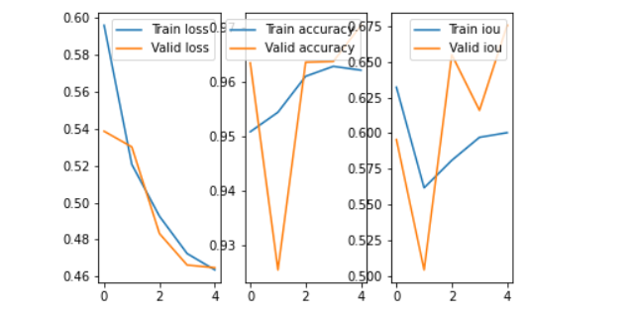
Object Detection
We have used Cosine learning rate annealing for object detection.
Findings:
Average Validation Accuracy – 0.9573
Average Validation IOU score – 0.6092

